Slide 1
Stock Market Simulator
Submitted By: Submitted To:
ADARSH THAKUR (194CA002) Ms. TEJASWINI GONDHALE
RAVI KUMAR GAUTAM (194CA036)
RAJAT KUMAR JAIN (194CA035)
HARENDRA SINGH (184CA024)
MUKESH KUMAR GUPTA (184CA040)

Slide 2
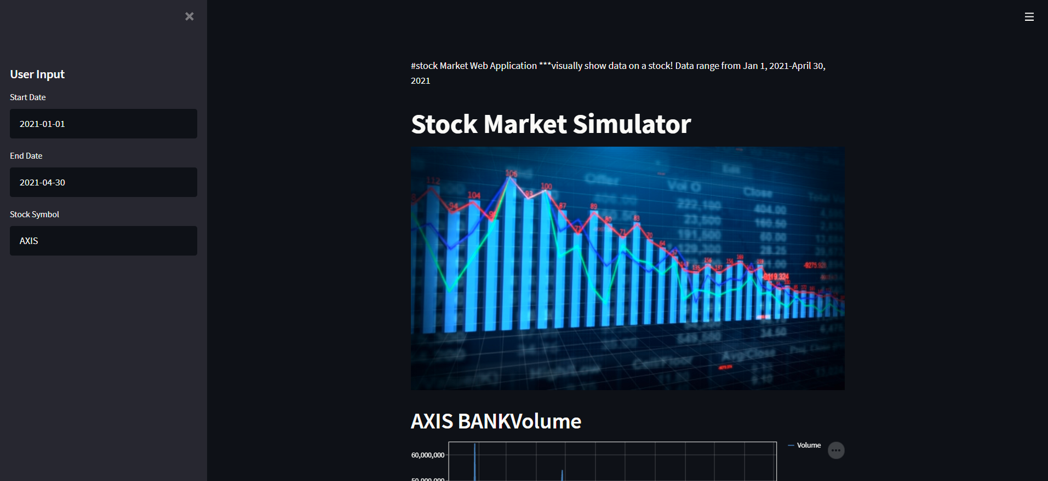
Our Home Page
FUNCTIONS USED IN HOME PAGE:-
st.write()
st.title()
image.open()
st.image()

Slide 3
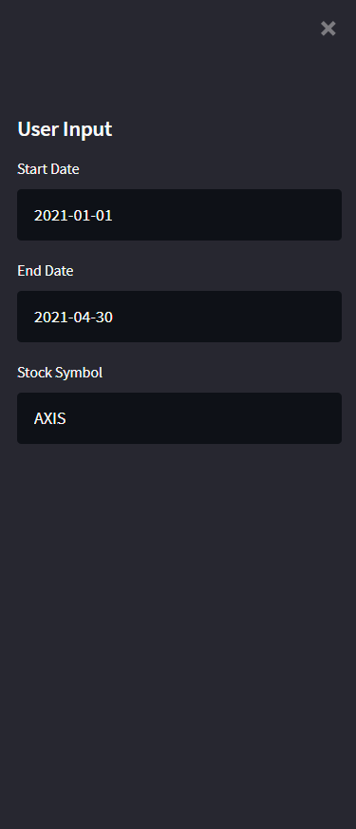
User Input Section
FUNCTIONS USED IN HOME PAGE:-
st.sidebar.header()
st.sidebar.text_input()

Slide 4
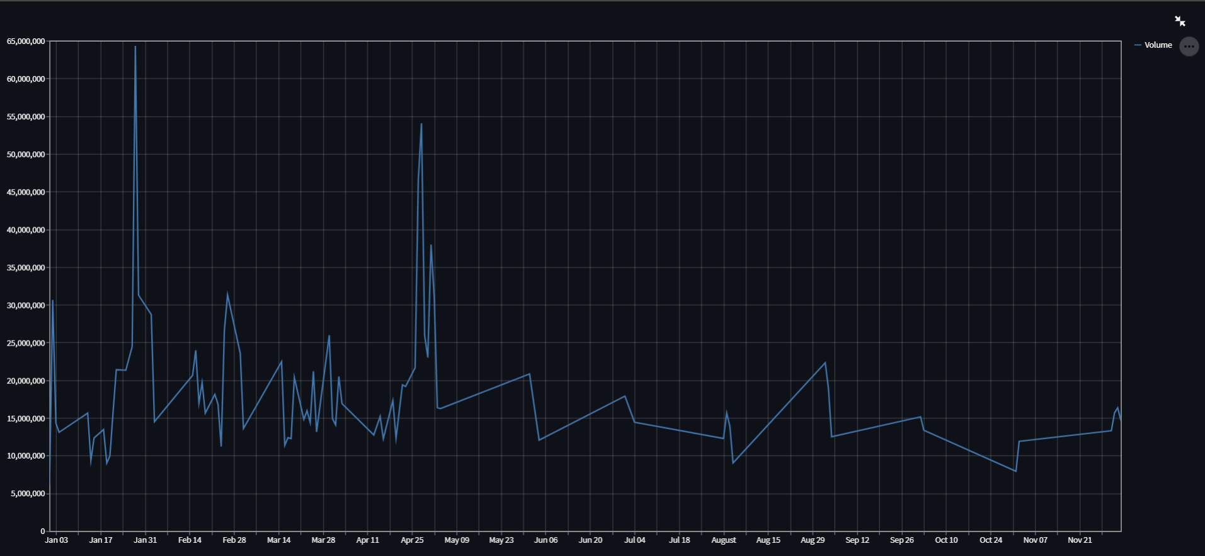
Line Chart visualization of any Company’s Data
FUNCTIONS USED IN HOME PAGE:-
st.header(company_name)
st.line_chart()

Slide 5
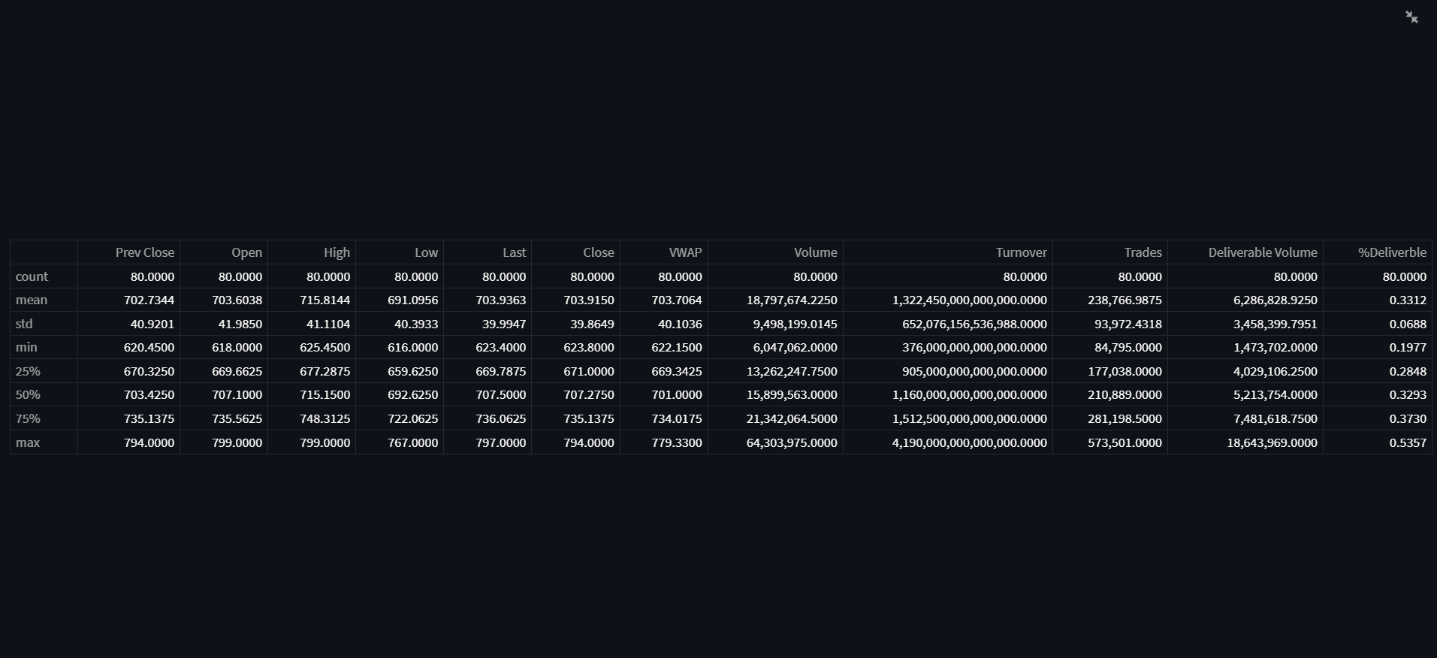
Statistics of Company’s Data
FUNCTIONS USED :-
st.header(‘Data Statistics’)
st.write(df.describe())

Slide 6
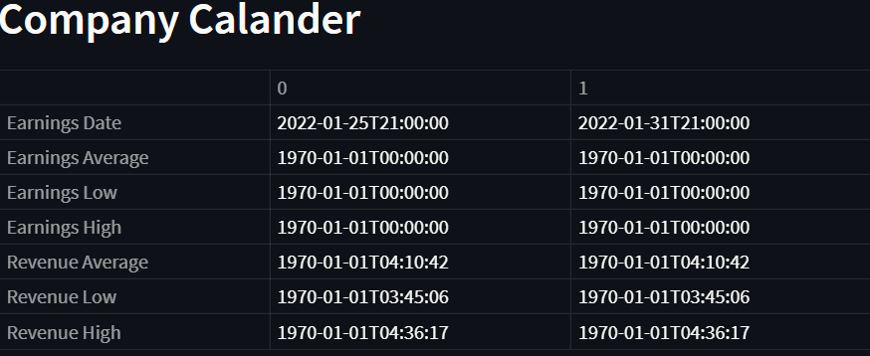
Company’s Calendar
FUNCTIONS USED :-
st.header('Company Calander')
st.write(tickerData.calendar)

Slide 7
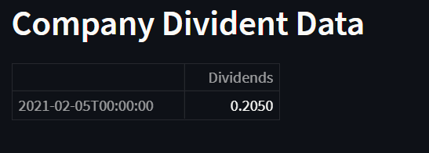
Company Dividend Data
FUNCTIONS USED :-
st.header('Company Divident Data')
st.write(tickerData.dividends)

Slide 8
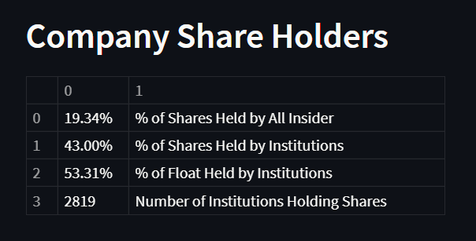
Company Share Holders
FUNCTIONS USED :-
st.header('Company Share Holders')
st.write(tickerData.major_holders)

Slide 9
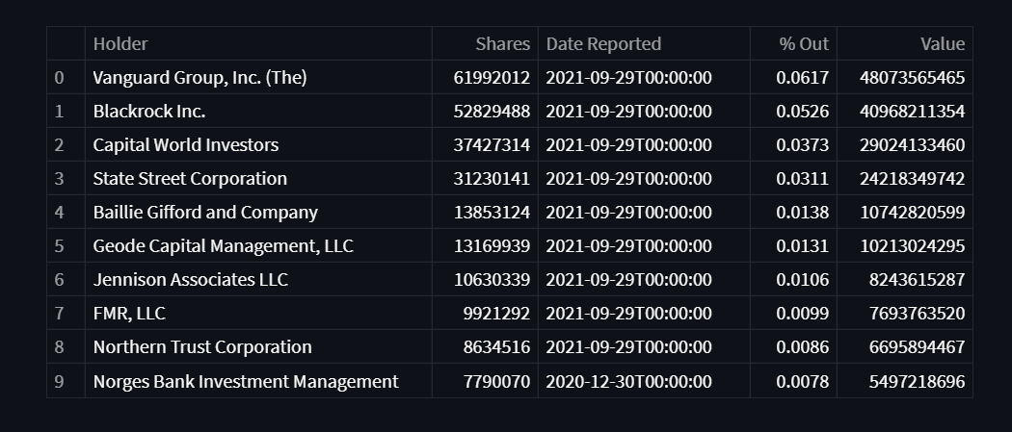
Company Institutional Investors
FUNCTIONS USED :-
st.header('Company Institutional Investors')
st.write(tickerData.institutional_holders)

Slide 10
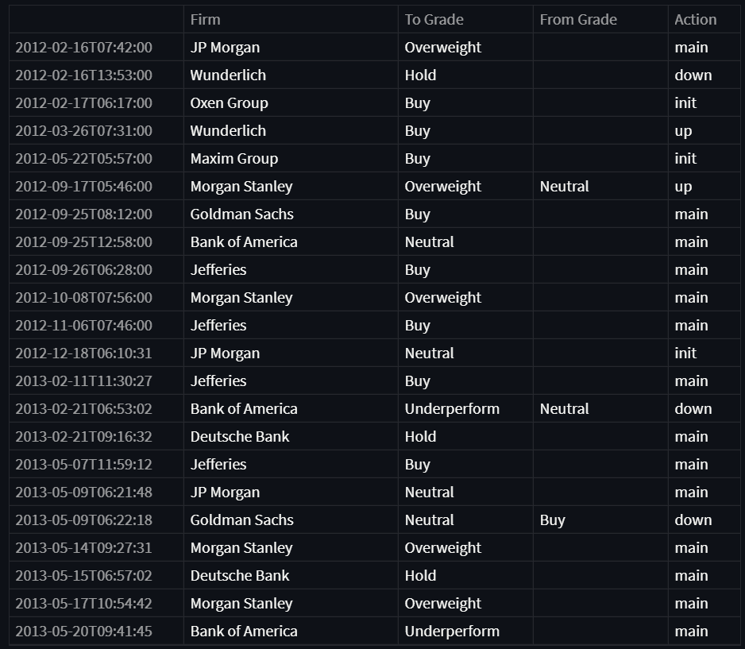
Company Recommendations
FUNCTIONS USED :-
st.header('Company Recommendations')
st.write(tickerData.recommendations)

Slide 11
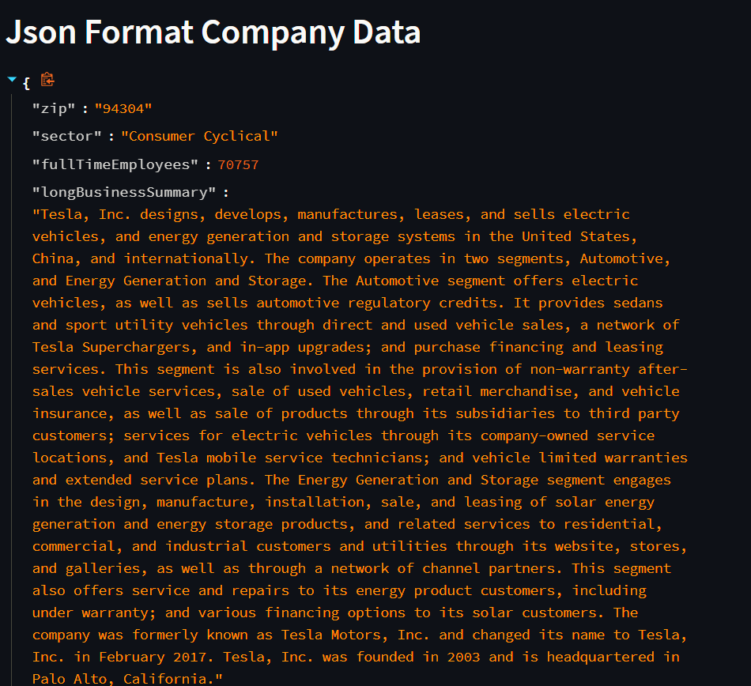
Json Format Company Data
FUNCTIONS USED :-
st.header('Json Format Company Data')
st.write(tickerData.info)

Slide 12
Libraries
import streamlit as st
from PIL import Image
import yfinance as yf

Slide 13
Code understanding
Input:
get_input() funtion:- To get the user input starting date, ending date, Stock symbol.
Data Fetch + API :
yf.Ticker(tickerSymbol)
tickerData.history(period='1d', start=start, end=end)

